Slide 1
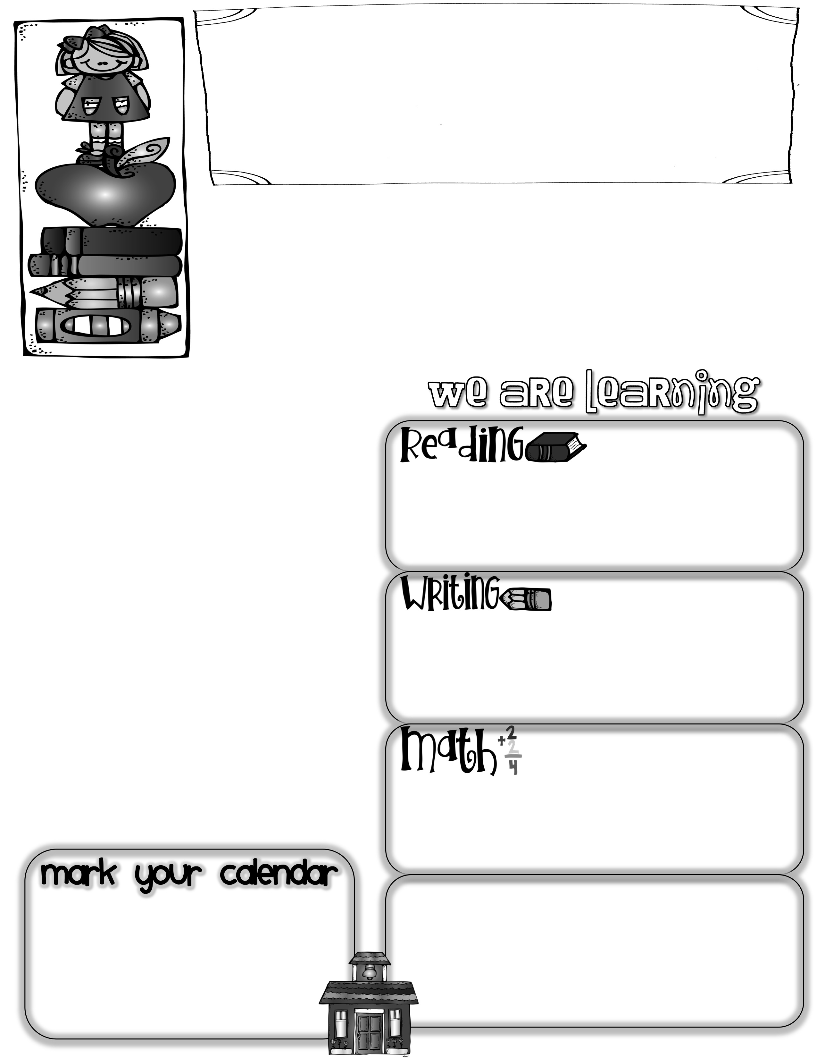
First Grade News
Mrs. Neilander
September 13, 2019
This week we completed our third science lesson about sound and how it travels by conducting several experiments. Through them, we learned that sound travels in waves through air, solids, and liquids by making vibrations. When we finish up sound, we will also study light and how it travels.
We have been learning about summarization and how it helps our brains to summarize what we have learned at the end of new concepts. As part of this, we have been writing quick notes to our class mascot, Ted E. Bear, to tell him the important parts of a lesson that he may have missed.
Author of the Week
Marc Brown (The Arthur series books)
Sight Words
The Big Cheese
We did a good job of completing the reading homework and returning the bags, books, and homework sheets this week. At this point, we all have the same list of sight words. Students will be tested once a week on those words, and move on to higher levels as they pass the first lists quickly and easily. If they miss more than a few on a list, they can study it to be tested again the next week. This week we tested on Monday, but it will normally be on Wednesdays.
Talia was our first Big Cheese. Talia has 3 sisters and loves soccer and singing. Her favorite subjects are Music, Math, and P.E. When she grows up, Talia wants to be a vet, dog trainer, singer, dancer, and chef. That sounds like a lot, but this girl is amazing enough to accomplish all that and more!
This week we discussed, brainstormed, and wrote all about avid readers and their habits. Most kids are getting fairly independent about making a circle map, then a tree map, then at least 3 complete sentences about the topic. We are editing for capitals at the beginning of sentences, finger spacing, periods at the end of sentences, and spelling.
Homework:
Our regular homework begins today. Inside today’s peechee is a homework folder for your child. This peechee needs to be returned on Monday as usual. The completed homework and homework folder can come in any day through Thursday-depending on when it is finished. Let me know if you have questions. Thank you!
We will continue working on solving
word problems and using counting-on strategies to solve addition problems. We also worked on making up our own word problems with missing whole numbers and missing parts. I teach them to always think if the problem is looking for a missing whole or part before beginning to solve.
Next week we will study the Fall Equinox, which falls on Monday, September 23rd. We will be doing several activities to teach the concept of the Equinox being equal hours of day and night. It would be fun if everyone would wear black (nighttime),
and white (daytime) on Monday.
Math Questions to ask your child:
*How many ways can you think of to make 9?
10? 12? 11?
*Can you make up a word problem where you have to find a whole number? A missing part?

