Slide 1
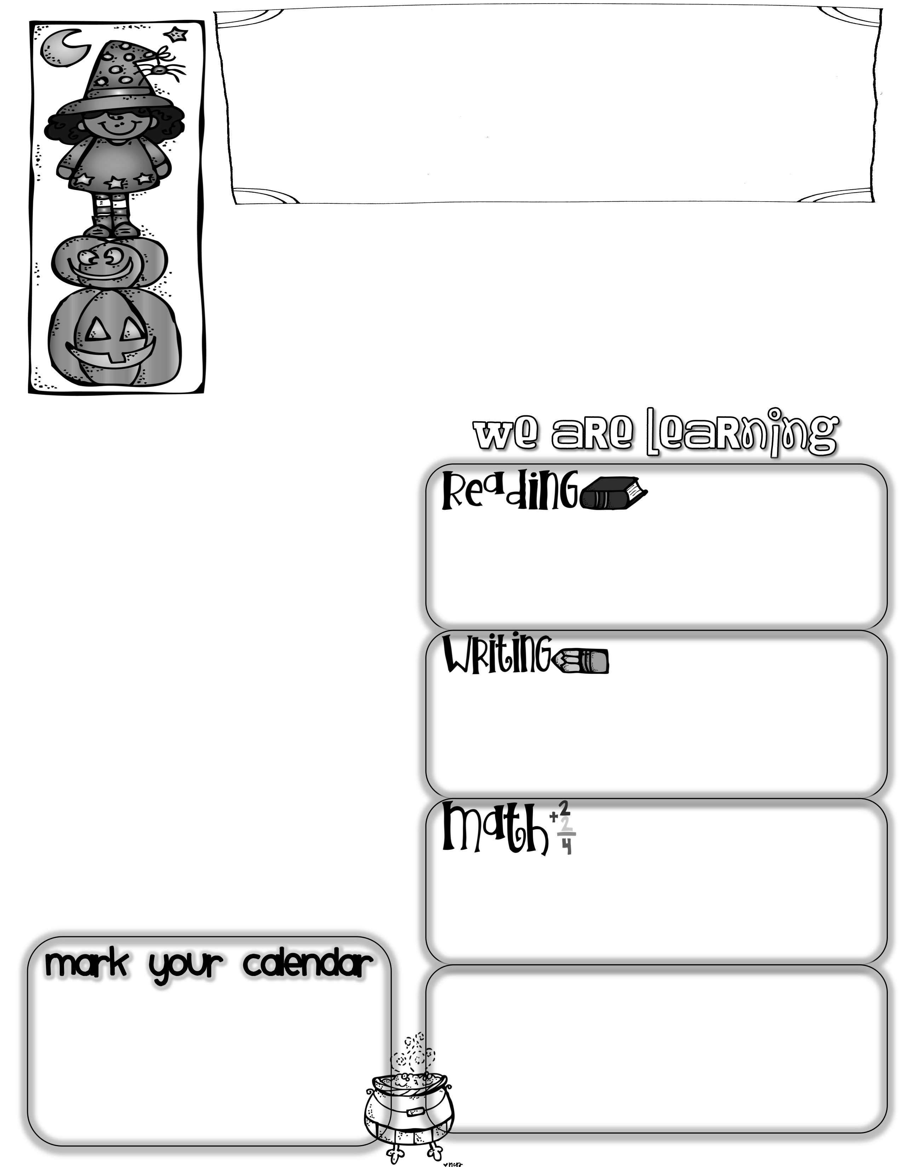
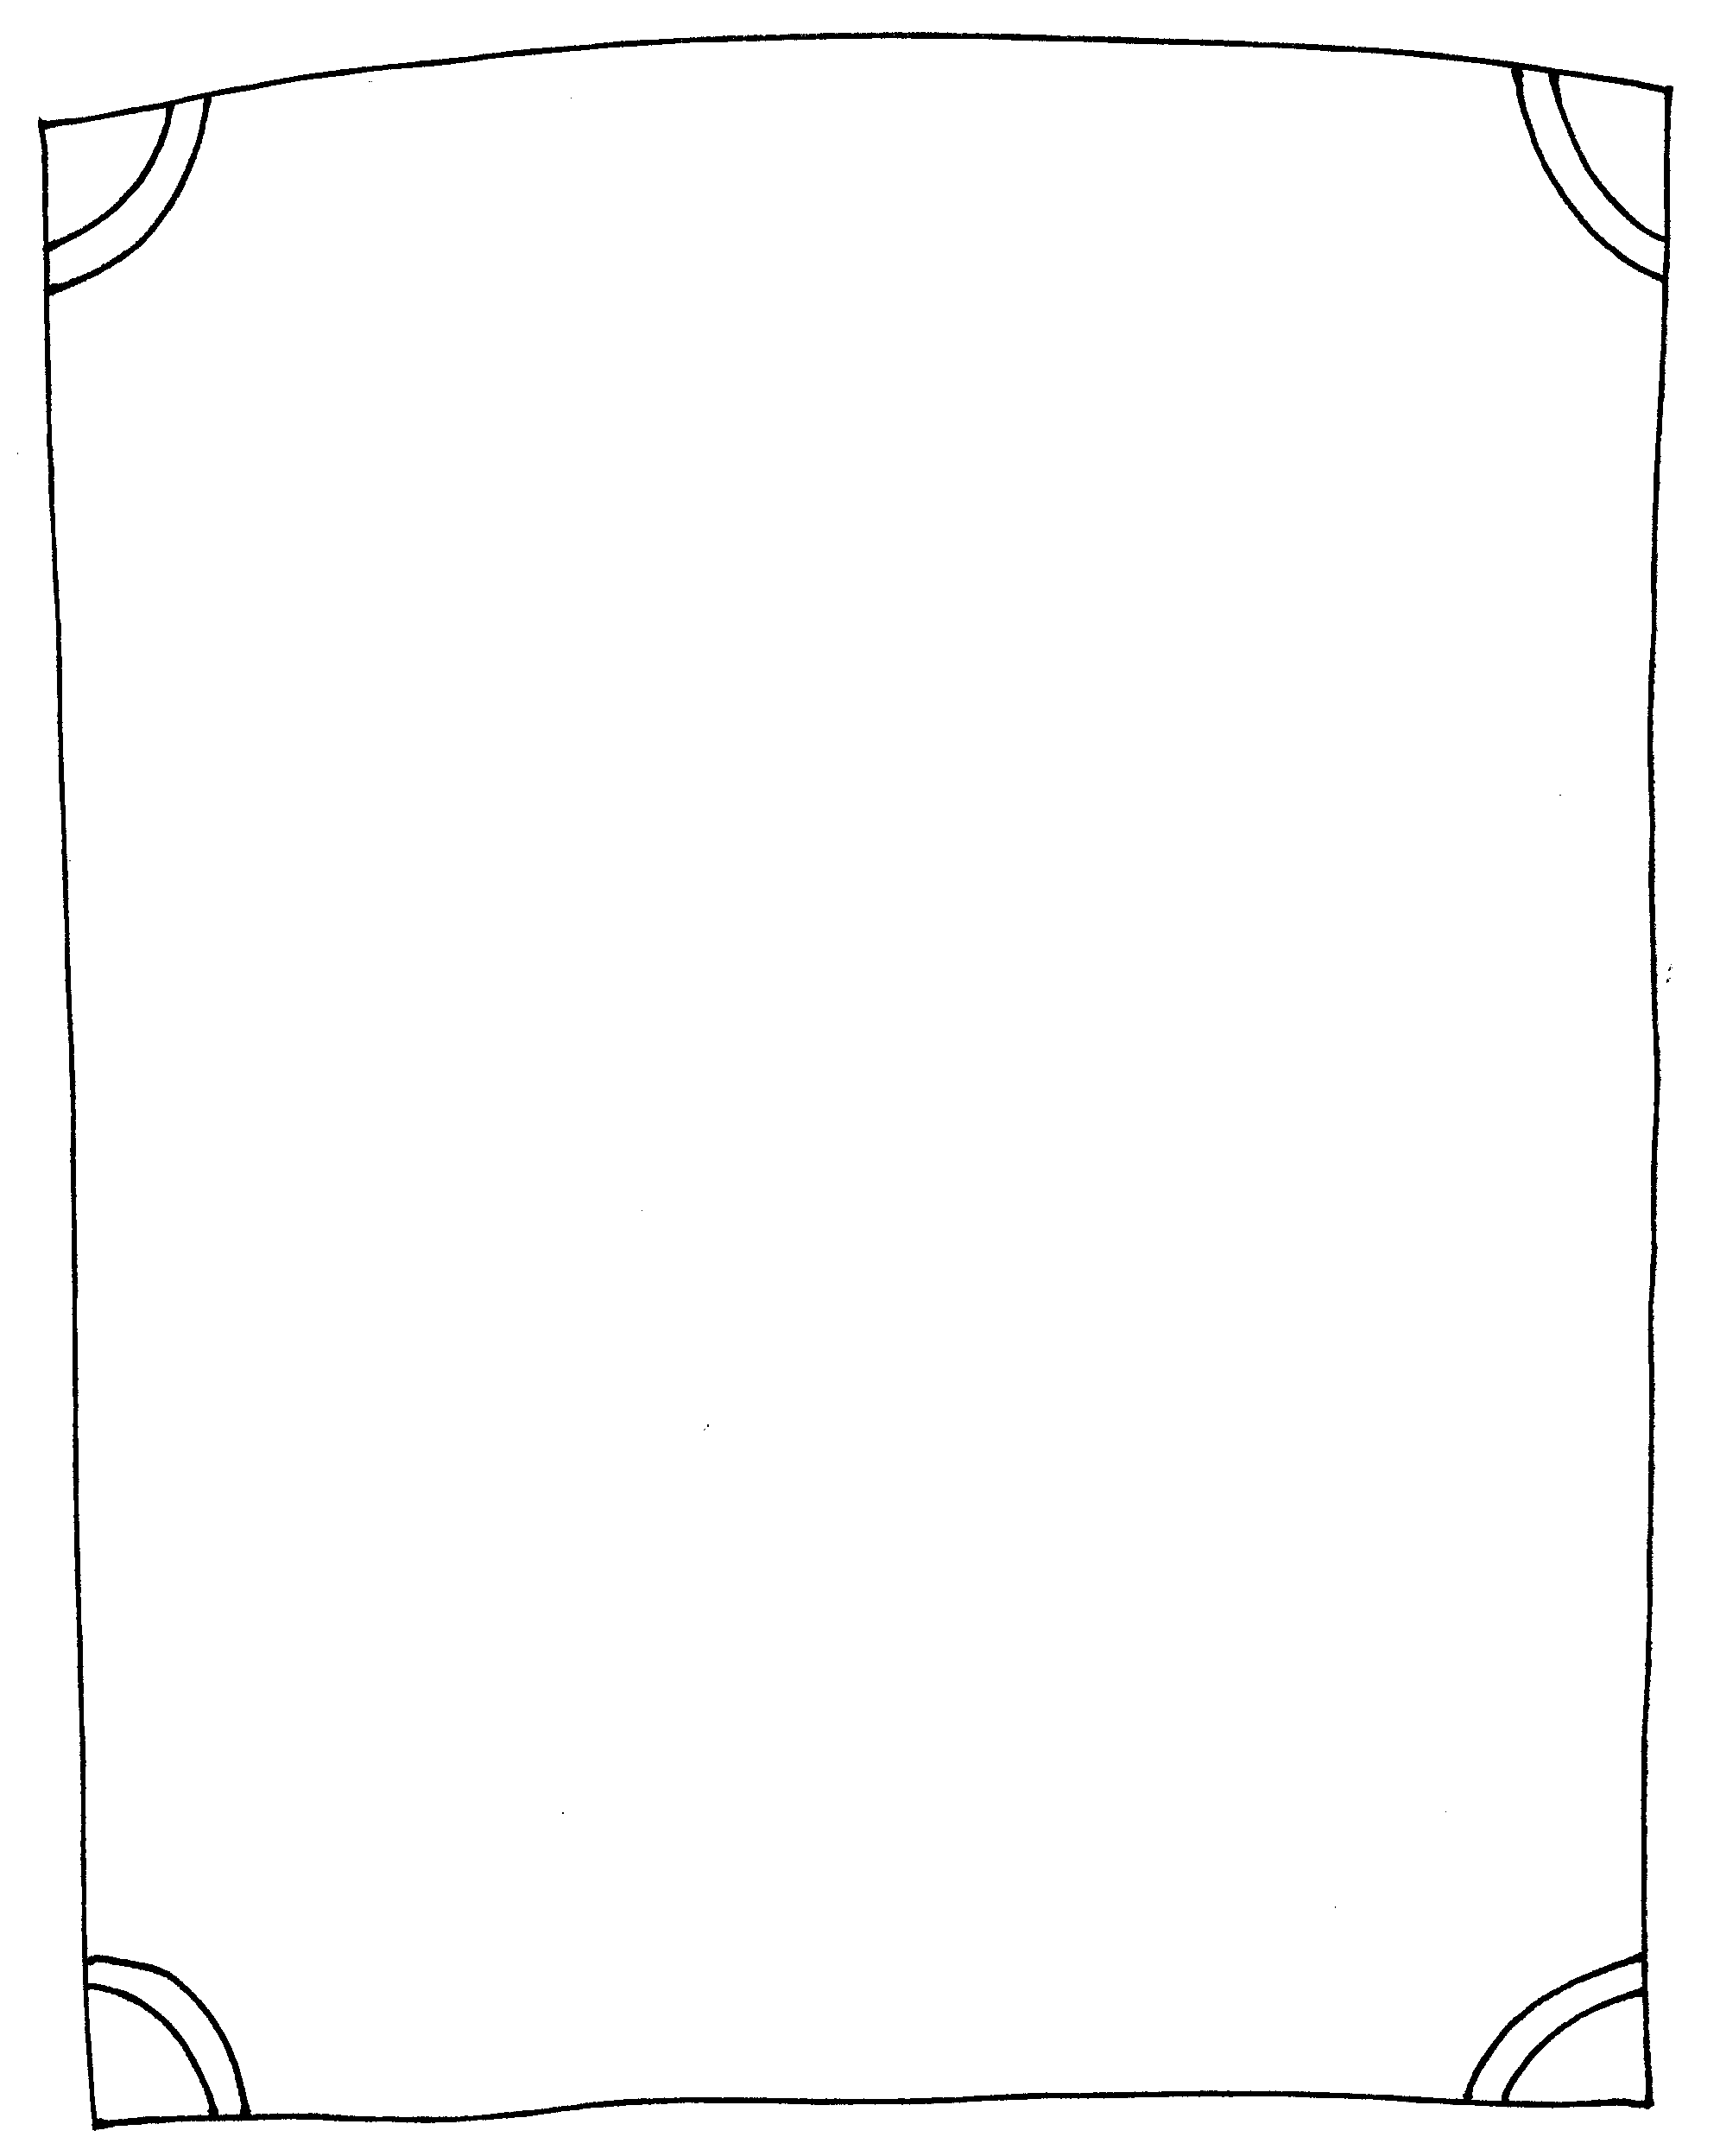
First Grade News
Mrs. Neilander
October 4, 2019
As you know, our annual Walk-A-Thon is scheduled for next Friday, October 11th. Our grade level runs from 9:30 to 10:30. The money is due on Thursday, October 10th. We use any funds earned from our class to help pay for field trips, so any donation is appreciated. Please have your child dress for the weather on this day (jackets or sunscreen), and make sure they have comfortable shoes for lots of walking or running. Our fabulous Parent Group is providing water bottles for the event.
Please save and send in fall leaves for a project next Thursday, October 10th.
Author of the Week
Tedd Arnold
The Big Cheese
We have been talking and practicing different strategies for solving unknown words when reading. Some that we have focused on include: looking at the picture, sounding out the whole word, getting a “running start”, double checking to make sure the word looks and sounds right, and flipping the vowel sound (trying the word with a short and a long vowel sound).
Miranda D. has been our Big Cheese this week. Miranda has two older brothers and they always make her laugh. She likes math, reading, and art. When she grows up, Miranda wants to be a teacher. What a wonderful one she will make some day!
We did not do a formal writing topic this week due to all our other activities. However, we did participate in the Cardboard Challenge with our 5th grade buddies. After watching the You Tube video entitled “Caine’s Arcade”, we worked with our buddies to design and build a cardboard arcade game. Be sure to ask your child all about their game.
Questions to ask your child:
*What is your favorite strategy for solving hard words when you are reading?
*Can you tell me the short and long vowel sound of each vowel? (Each long vowel says its name.)
*What is an open syllable? (ends with a long vowel- hi, so)
*What is a closed syllable? (ends with a consonant- pop, jet)
This week’s math lessons went
into linking subtraction with the addition problems we have been doing. We’ve been exploring the relationships between addition and subtraction, and working on strategies to solve subtraction problems.
Math Questions to ask your child:
*What are some strategies to use when solving subtraction problems? (counting backwards, taking things away, number bonds)
*Can you make 4 equations (2 addition and subtraction) from these numbers: 3,5,8?
*Next Wednesday, Oct. 9th, is a late start day. School begins at 10:20.
*Our Fall Break is quickly approaching. There will be no school during the week of October 21st - 25th.

